Slide 1


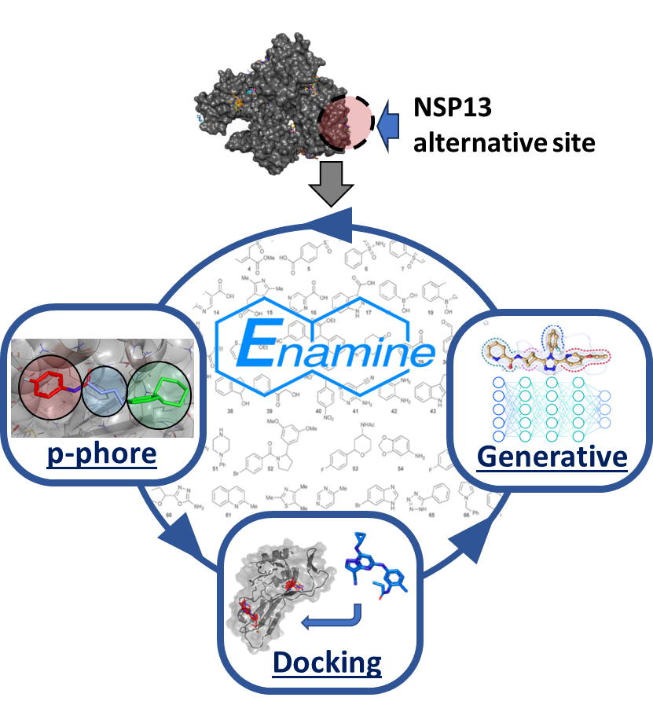
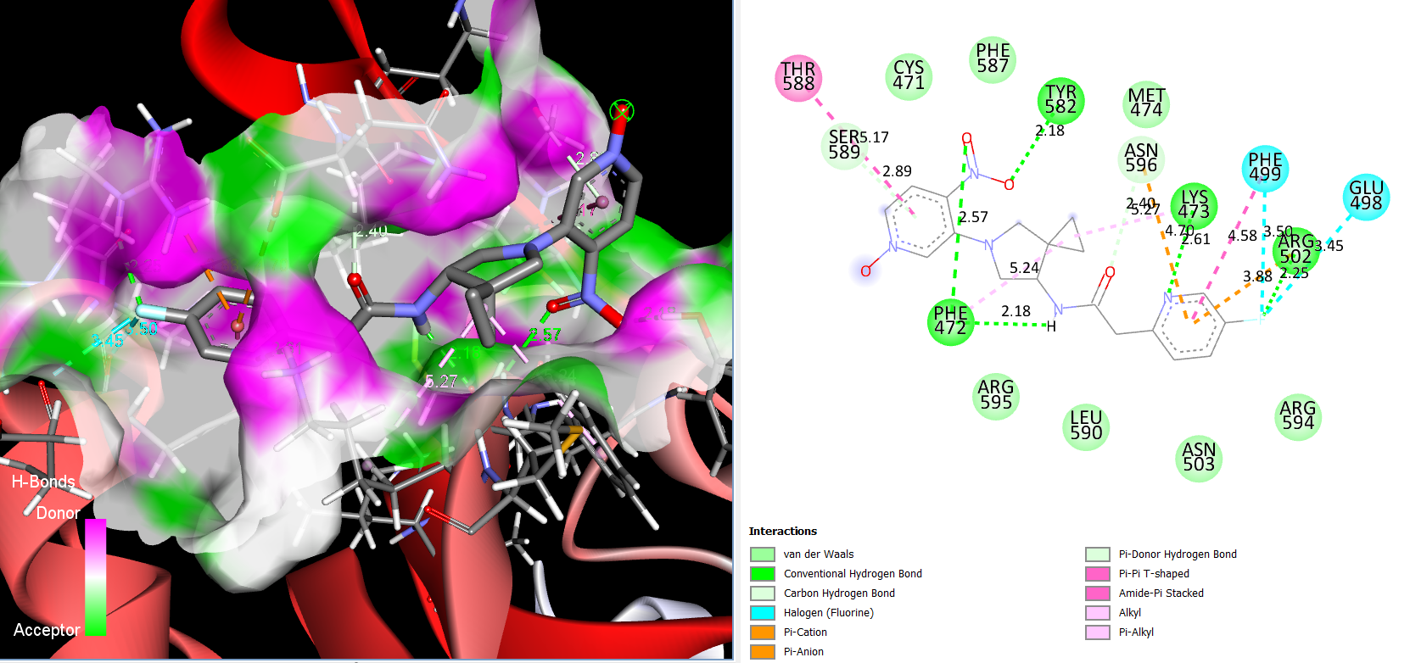
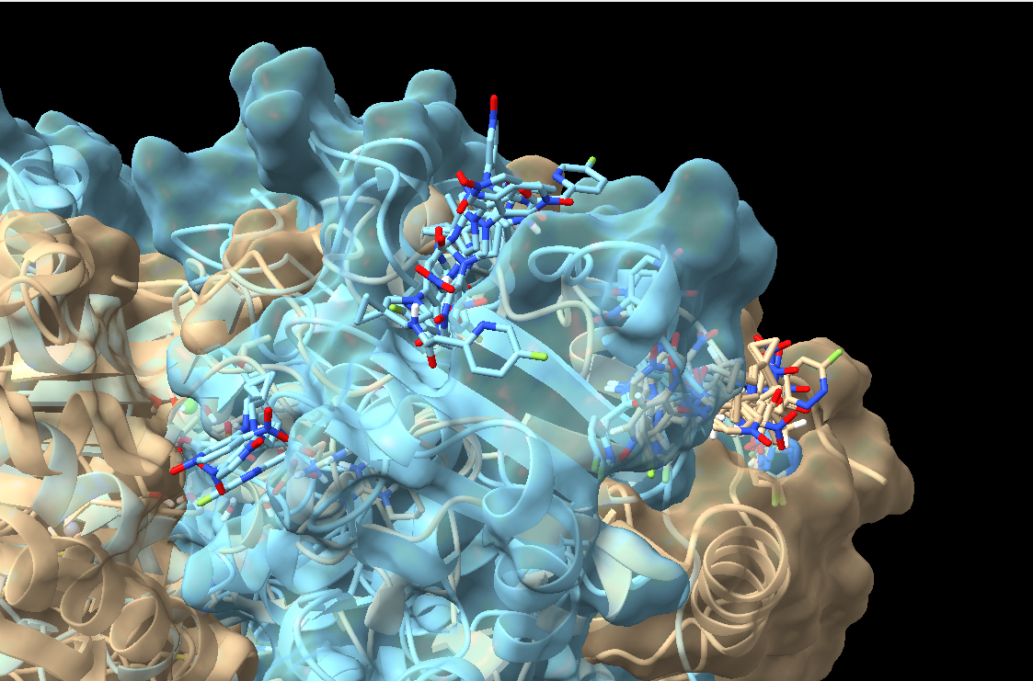
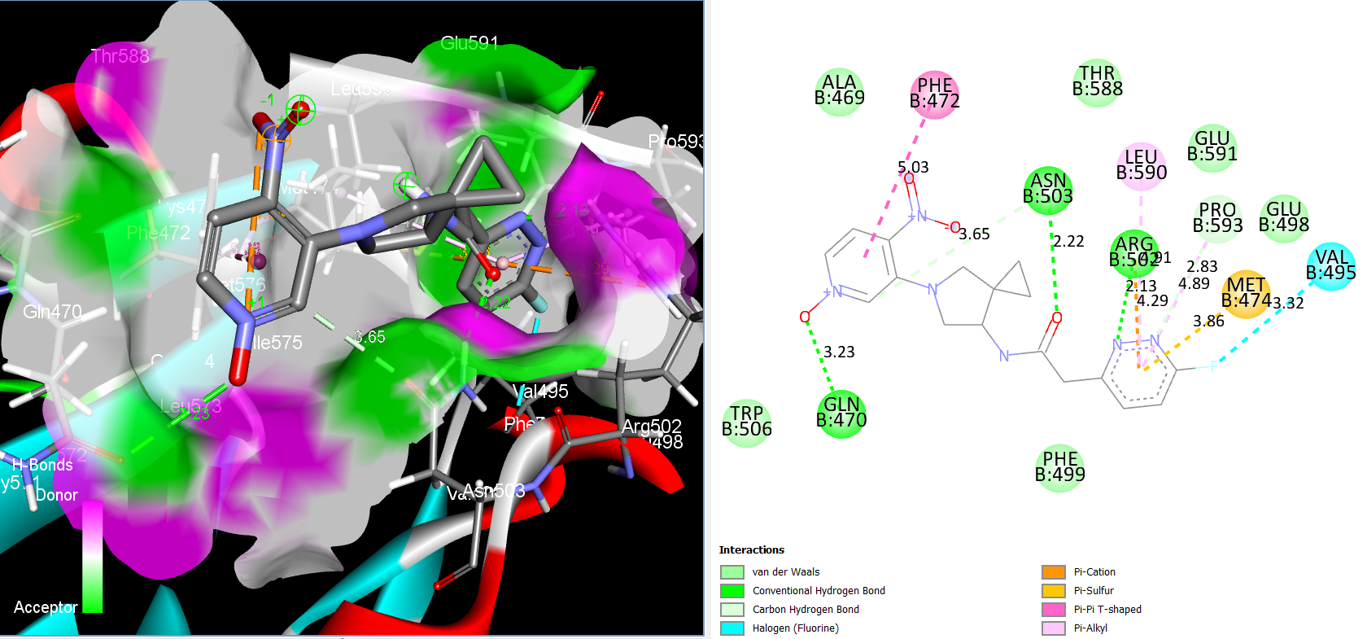
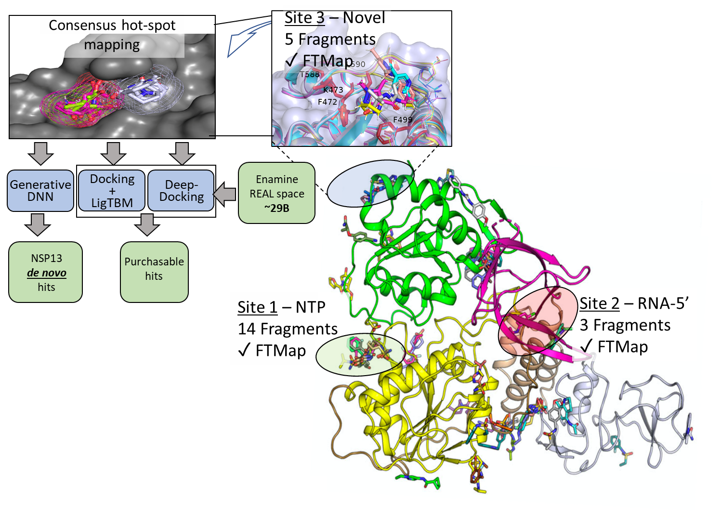
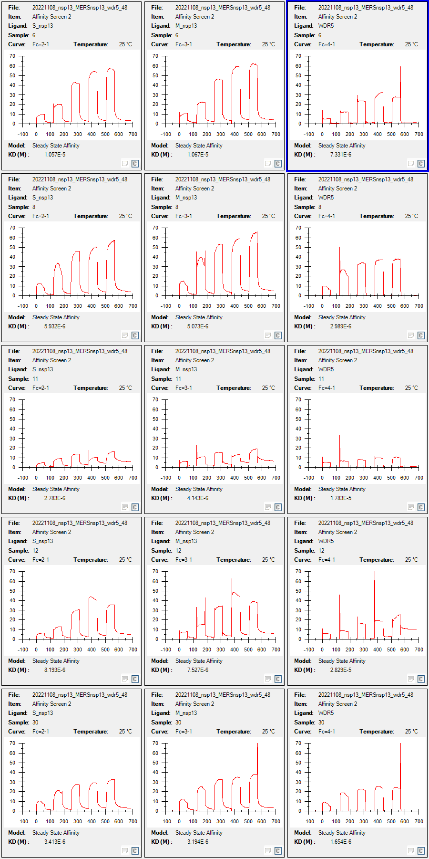
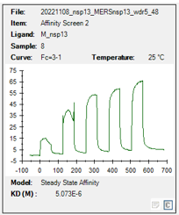
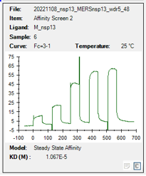
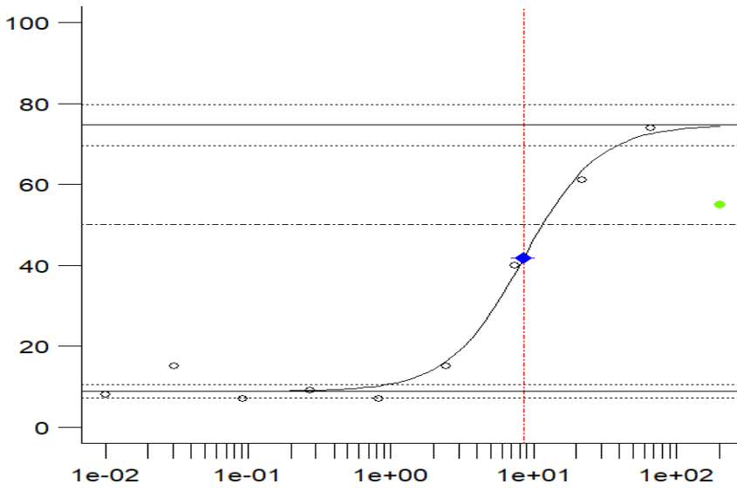
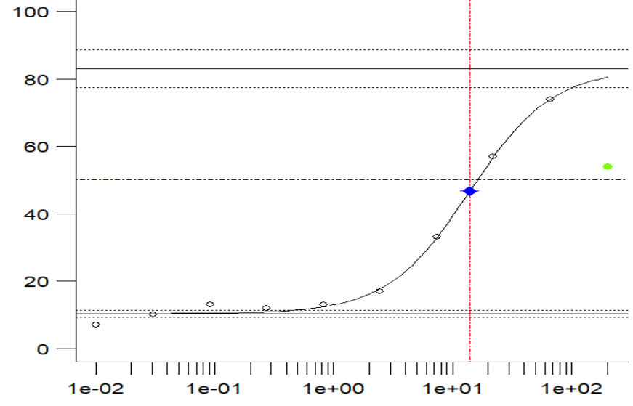



Identification of SARS-CoV-2 helicase inhibitors by large-scale virtual screening
Mohammad Anwar Hossain¹, Konstantin Popov², Sumera Perveen³, Thomas Knight⁴, Kesatebrhan H. Asressu¹,
Kenneth Hugh Pearce Jr.², Cheryl Arrowsmith³, Peter J. Brown¹, Matthew Todd⁴, Alexander Tropsha⁵, Tim Willson¹
¹SGC-UNC, ²CICBDD, ⁵CBMC, UNC Eshelman School of Pharmacy, The University of North Carolina at Chapel Hill, NC, USA; ³SGC, University of Toronto, Canada; ⁴UCL School of Pharmacy, London, UK
Introduction
Large-Scale Virtual Screening
MD Simulation of De Novo Hits
Facts: The Rapidly Emerging Antiviral Drug Discovery Initiative – Antiviral Drug Discovery Center (READDI-AC) aims to expedite the discovery and preclinical development of orally bioavailable, direct-acting antivirals with broad-spectrum activity against Alphaviruses, Flaviviruses, Coronaviruses, and Filoviruses, all possessing high pandemic potential.¹
Pdb: 7KRO (nsp13-ATP-ssRNA) at 0ns/100ns
Notable C-term-B pocket shape difference when ssRNA bound to part of the RTC complex.
1.Fragment-based pharmacophore modeling⁴
4.Biased generative modeling
Pdb: 5RM9 (fragment-nsp13)
Goals:
Employ an integrated, evidence-based approach to design allosteric inhibitors targeting SARS-CoV-2's NSP13 helicase.
Develop and validate these inhibitors, assessing their potential as COVID-19 therapeutic agents.
2. 40B similarity search
3. Docking & scoring
100 ns AMBER simulation:
ssRNA interaction with nsp13 induces deeper pocket formation
Ligand is highly flexible with numerous binding modes.
Weak (Pi-Pi, Pi-alkyl, and Pi-cation) interactions frequently occur → pyridinium-N-oxide more likely acts as an electron-deficient region for pi interactions
Viral Helicases:
Potential drug targets influencing RNA/DNA metabolism
Involved as key motor enzymes
Key functions:
Unwinding & Energy Utilization
Regulation of Viral Processes
Host Interaction
Druggability of Helicases: Limited evidence^{2,3}
Data from phenotypic screenings
Insights from biochemical assays
Purchasable hit set
Physicochemical properties Commercial availability Chemical Diversity
De Novo hit set
Physicochemical properties Synthetic feasibility
Drug like hits
Challenges
NSP13 is a motor enzyme which makes it difficult to identify inhibitors by rational design
Lack of positive control for NSP13 ATPase assay
No known helicase inhibitors active in SPR
Parameter | Range of Values | Ro5 Comments
MW | 260 to 460 | No-violation
cLogP | -1.9 to 2.5 | No-violation
cLogS | -6.8 to -3.5 | -
tPSA | 75 to 130 | -
HBA | 6 to 10 | No-violation
HBD | 1 to 3 | No-violation
Conclusions
We've recognized viral helicases as promising therapeutic targets
Novel NSP13 helicase binding site (Site #3) discovered, offering a unique drug target
Identified micromolar effective NSP13 helicase inhibitors, setting a solid groundwork
MD simulations revealed how nucleic acids impact ligand binding, enhancing our drug design strategy
Hit expansion in the READDI-AViDD program is ongoing, broadening potential drug candidates
Despite a hit identified in biochemical assays, further optimization is needed due to the lack of inhibition in cell-based viral growth assays
Rational design of allosteric helicase inhibitors
Physicochemical properties of selected hits
Representative de novo hit synthesis scheme
Compound screening
51 Purchased hit compounds
DeNovo Synthesis hits
SARS-COV-2 ATPase & SPR
MERS SPR Assay
Antiviral Assay, Crystallography
Observed activity confirmation
New SAR Design
Results: NSP13 SPR and ATPase
References
Approaches to validate the hits:
Re-synthesis of the top hits
X-ray crystallography
Synthesis of a small set to generate SAR
T#3
T#2
T#1
1. https://www.readdi.org/
2. https://doi.org/10.1021/acs.jmedchem.2c00668
3. https://doi.org/10.7554/eLife.65339
4. https://doi.org/10.1038/s41467-021-25166-6
ID
RA-0001264
RA-0001263
T#1: Study importance of presence of N-oxide
SPR KD
SARS-2 6 µM
MERS 5 µM
SARS-2 11 µM
MERS 11 µM
T#2: Explore the impact of other diamines
Acknowledgment
Is NSP13 Helicase druggable?⁴
Site#1: NTP binding site soaked with 14 fragments
Site#2: RNA binding site soaked with 3 fragments; potential for PPI design
Site#3: Identified as a novel site soaked with multiple fragments. Potential for novel allosteric inhibitors
T#3: Thiazoles replacement
Funding Support: NIH 1U19AI171292-01 (READDI-AViDD Center)
SARS-CoV-2
ATPase IC₅₀
48 µM
12 µM
Anwar.Hossain@unc.edu
Parameter |  | RA-0001264 |  | RA-0001263
MW |  | 346.41 |  | 342.35
cLogP |  | 0.14 |  | -0.32
Kinetic Solubility |  | > 180 (µM) |  | > 195 (µM)
Hill slope = 1.7
Hill slope = 1.4
Tim.Willson@unc.edu
ATPase IC₅₀ = 14 µM | SPR (KD) = NA
Kinetic Solubility = 142 µM
-ssDNA +ssDNA

